Slide 1
Our journey has begun
“Far from what I once was but not yet what I’m going to be”

Slide 2
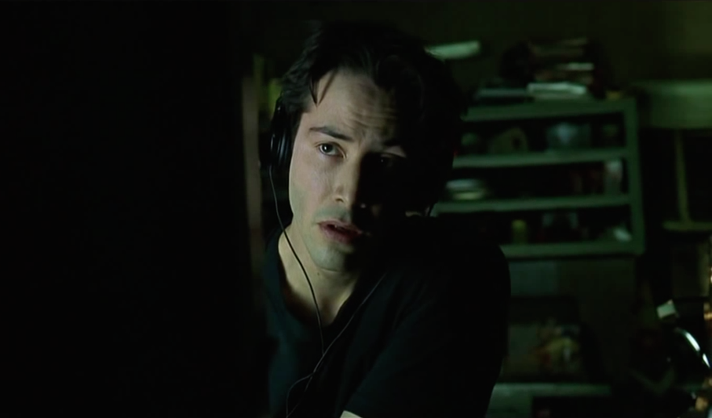

My first weekend
Git
Commandline
In the pub with the other class

Slide 3
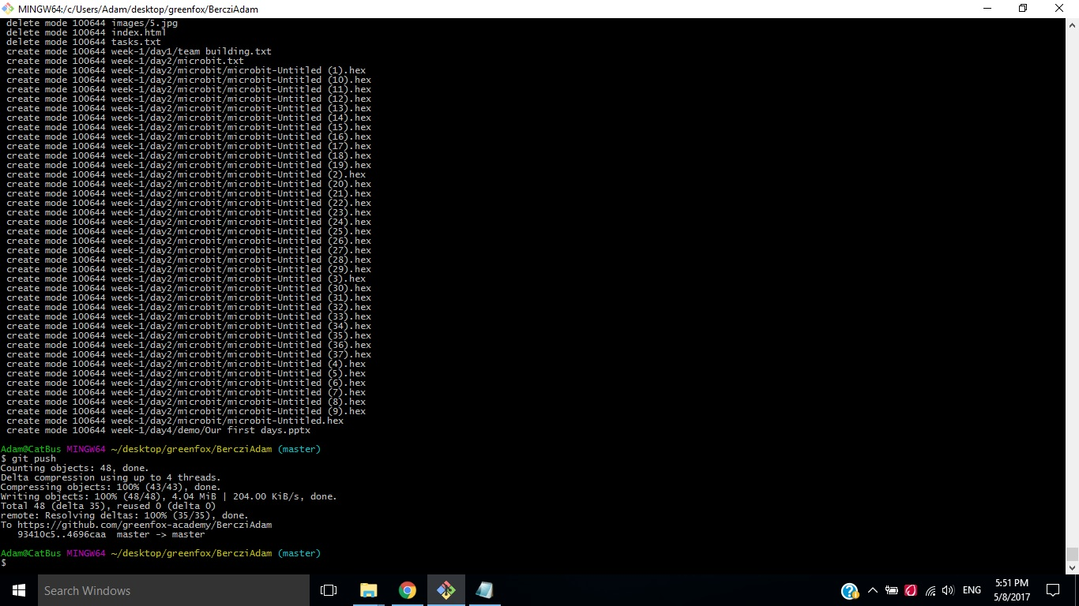
First Day
I tought i’m cool

Slide 4
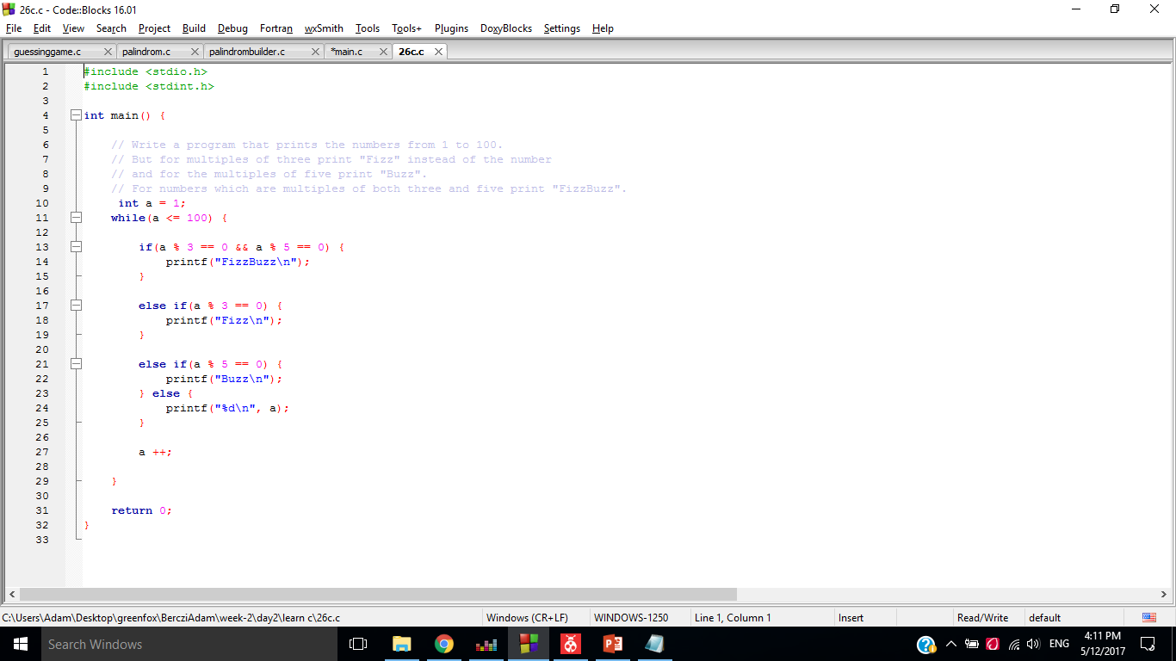
sECOND day
Still cool…
))

Slide 5

Third day
I will be fine without studying
ATMEL MINDFUCK…
Timer
Interrupt

Slide 6

fourth day
Arrays, pointers
Atmel UART
Teamwork

Slide 7
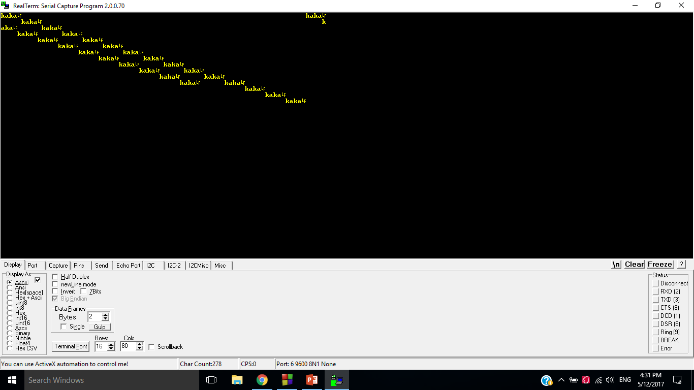
Fifth day
Project
Don’t get drunk if your friends say so
Just survive the day
Guessing game
Palindrombuilder

